Slide 1
PROJECT TITLE:- An Ambulance for fast and reliable Emergency Medical Services- SWIFT EMS
PIP104 University Project-II
Review-1
Batch Number: G-45
Roll Number | Student Name
20201CSE0334 | Preetham A A
20201CSE0333 | Neesha Kundu
20201CSE0283 | Divya Prakash
20201CSE0340 | Owaiz Ahmed Shariff
Under the Supervision of,
Dr. Vijaya Kumar A V
Professor
School of Computer Science & Engineering
Presidency University

Slide 2
Introduction
In today's fast-paced world, access to immediate emergency medical care can mean the difference between life and death. However, the existing systems for dispatching and coordinating ambulance services often fall short of providing the swift and reliable response needed during critical moments. This is where our ambitious project comes into play.
We are excited to introduce you to our groundbreaking initiative—a state-of-the-art Ambulance Service Web App. Our mission is clear: to transform the way emergency medical care is delivered, ensuring that help is just a few taps away when it's needed most.
The project is born out of a deep understanding of the challenges plaguing current ambulance services. Delays in response times, a lack of coordination between dispatch centers and ambulance drivers, and inefficient communication channels have all contributed to suboptimal emergency medical care.

Slide 3
Literature Review
“Dynamic Routing for Emergency Vehicle” – Ryo Katsuma:
When a natural disaster such as earthquake strikes, people go away to safety areas by cars. Some roads are broken and impenetrable by buildings falling down. Furthermore, some fixed infrastructures for radio communication may be broken. In order to quickly bring ambulances and fire trucks to their destinations, it is necessary to provide real-time road conditions to these emergency vehicles via ad -hoc networks. In this paper, proposed a method to periodically reconstruct a route for an emergency vehicle by collecting real- time road conditions via vehicle ad-hoc networks. As simulation results, we confirmed that the proposed method collects 12% more road conditions than existing method. We also confirmed that the proposed method achieves 10% faster arrival than the existing method.

Slide 4
Literature Review
2. “Geographic Information Systems (GIS) in Public Health: A Review of Applications and Opportunities” – E. C. Fradelos:
The study highlights the versatile applications of GIS technology in addressing public health challenges, from disease surveillance and tracking to resource allocation and epidemiological analysis. It emphasizes the power of spatial data in decision-making, allowing public health professionals to visualize and analyze health trends, assess environmental factors, and plan interventions effectively. The paper showcases the potential of GIS in improving public health outcomes, offering a valuable resource for researchers, policymakers, and practitioners seeking to harness geospatial data for better health management.

Slide 5
Literature Review
3. “A Closer Look on the User-Centered Design” – Adriana Chammas:
The paper underscores the fundamental idea that designing products and systems with the end user in mind is essential for creating effective, user-friendly solutions. It delves into the various stages of UCD, from user research and needs analysis to prototyping and usability testing. The paper emphasizes the importance of iterative design, where user feedback informs refinements. UCD is shown to enhance user satisfaction, usability, and overall product success, making this paper a valuable resource for designers, developers, and anyone involved in creating user-centric solutions.

Slide 6
Proposed Method
Project Initiation: Define the project’s objectives, scope and stakeholders. Identify available resources, budget, and timelines.
Requirement Gathering and Analysis: Our primary objective is to significantly reduce ambulance response times. We aim to ensure that when a medical emergency occurs, help arrives as swiftly as possible, increasing the chances of saving lives and improving patient outcomes.
Design and Prototyping: Create wireframes and prototypes of the app's user interface (UI) and user experience (UX).
Development: Begin the development of the web app and server components concurrently.

Slide 7
Objectives
To Improve Response Times: Our primary objective is to significantly reduce ambulance response times. We aim to ensure that when a medical emergency occurs, help arrives as swiftly as possible, increasing the chances of saving lives and improving patient outcomes.
To Enhance Coordination: We seek to establish seamless coordination between emergency helpline operators, ambulance services, and healthcare facilities. Our goal is to minimize miscommunication and streamline the entire process from call to arrival at the medical facility.
To allow easy registration: The project aims to provide drivers to register anytime and anywhere to make their services available at any time.
To have User-Centric Design: We aim to create an intuitive, hassle-free interface for users facing medical emergencies. The app should be easy to navigate, even in high-pressure situations, reducing user anxiety.

Slide 8
Expected Outcomes
To Reduce Response Times: Quick dispatch and response is expected ensuring that critical medical assistance is provided promptly during emergencies
To find shortest route: The project aims to help navigate the ambulance to follow the shortest route to the emergency location.
To have User-Friendly Experience : The app's interface will be intuitive and stress-free, ensuring ease of navigation even during high-pressure situations, thereby alleviating user stress and anxiety.

Slide 9
Methodology
Frontend Development:
Integrated Development Environments(IDE): Visual Studio/ Android Studio
Programming Languages: Java/ React Native
UI/UX Design Tools: Figma
Backend Development:
Web Application Framework: Firebase by Google
Database Management: Firebase by Google
APIs used: Google Map API
Source Control:
Git for tracking changes in codebase

Slide 10
Methodology
Start
Sign up/Sign in
Set location
Book an ambulance
Get the service
Allow location permissions

Slide 11
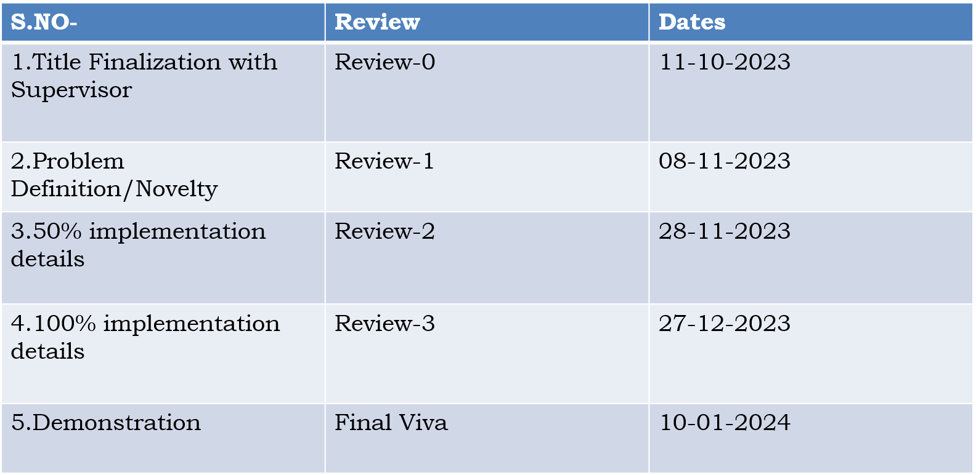
Timeline of Project

Slide 12
Conclusion
In conclusion, the development of an Ambulance Service Web App is a crucial step forward in transforming the way emergency medical care is delivered. This project addresses significant challenges in the current emergency medical care system and aims to provide a reliable, efficient, and user-friendly solution for individuals in need of urgent assistance. The project objectives are clear: to reduce ambulance response times, enhance coordination between emergency helplines and ambulance services, and improve communication between users and ambulance drivers. The app is designed to ensure the safety and well-being of individuals during medical emergencies, offering a lifeline when it's needed the most.
The scope of the project encompasses a robust feature set for both users and ambulance drivers, as well as integration with an emergency helpline service. To ensure data security and compliance with healthcare regulations, the project places a strong emphasis on privacy and security. During the development phase, careful attention will be paid to creating user-friendly apps for both users and ambulance drivers, a scalable and efficient backend system, and comprehensive testing to ensure the app's reliability and performance.

Slide 13
References
Dynamic Routing for Emergency Vehicle-
Research by Ryo Katsuma · January, 2018 · International Journal of Communications Network and System Sciences · ISSN(e): 1913-3723 · ISSN(p): 1913-3715 · PP:27-44 Vol. 11, Issue 02
Geographic Information Systems (GIS) in Public Health-
Research by EC Fradelos · December, 2014 · Acta Inform Med· ISSN(e): 1986-5988 · ISSN(p): 0353-8109 · PP: 402-405 Vol. 22, Issue 06
A Closer Look on the User-Centered Design-
Research by Adriana Chammas · December 2015 · Procedia Manufacturing · ISSN: 2351-9789 · PP: 5397-5404 Vol. 03
Mobile-Based Medical Emergency Ambulance Scheduling System-
Research by Bassey Isong · November, 2016· International Journal of Computer Network and Information Security · ISSN(e): 2074-9104 · ISSN(p): 2074-9090 · PP: 14-22 Vol. 08, Issue 11

Slide 14
Thank You

